Slide 1
QA Testing
As the Director of QA, my responsibility is to ensure that the development team conduct manual testing contract modules for simple authorization and access control mechanisms.
Once mining is completed and we have obtained Ethers its time for the smart contract to be deployed and perform testing on the performance transactions. We have standardize on Ganache, Truffle tool to emulate an Ethereum blockchain to perform testing of the smart contract.

Slide 2
Testing Environment Housing Auction
The process used is called a local blockchain. A slimmed down version of the real thing, disconnected from the Internet, running on a machine. No Ether needed, and new blocks mined instantly.
Utilized Remix for deployment, Solidity for contract development, Ganache and Truffle as testing tools.

Slide 3
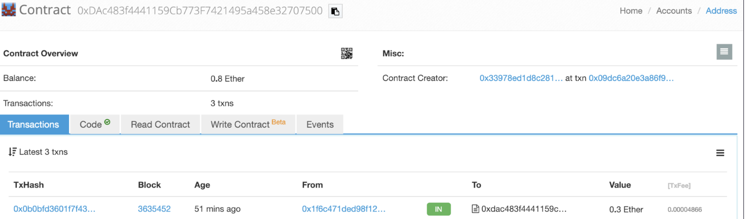
Status of Contract Posted on Ropsten, Kovan and Rinkeby Test Networks

Slide 4
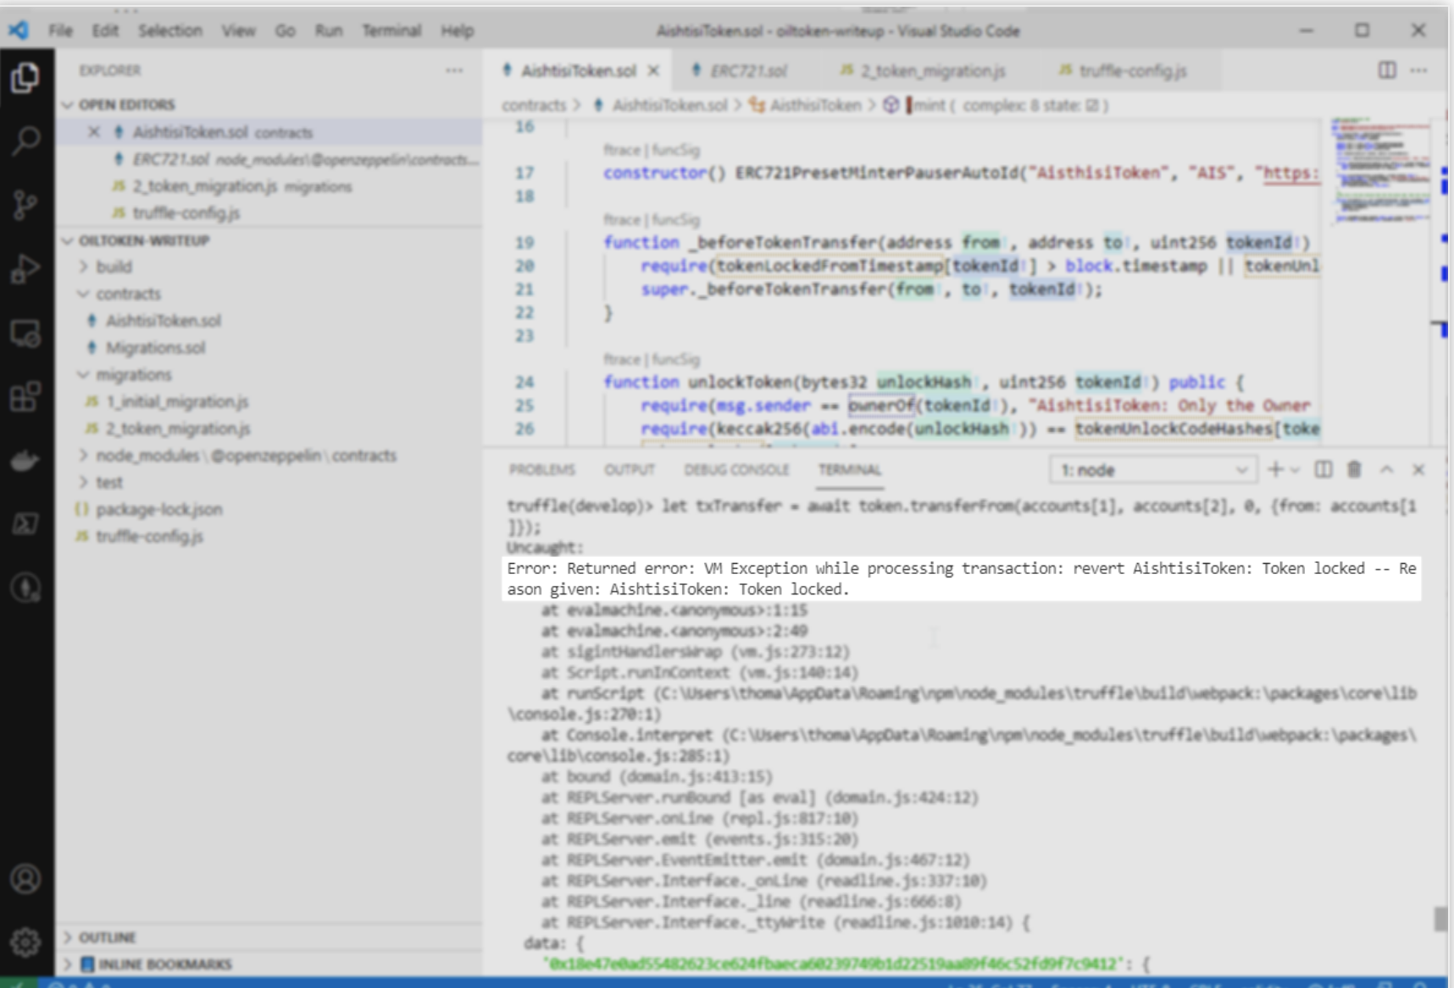
Function
Highest Bid
event HighestBidIncreased(address bidder, uint amount);
If the highest bid is raised, the previous highest bidder gets their money back. After the end of the bidding period, the contract has to be called manually for the beneficiary to receive their money

Slide 5
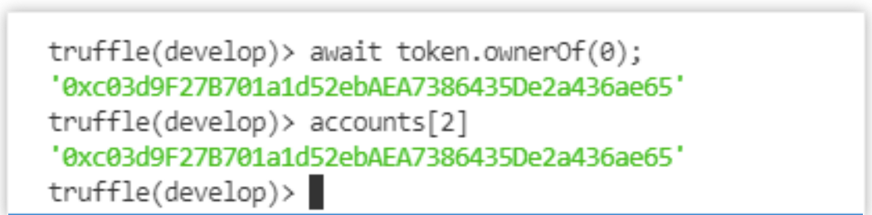
Current Owner of Token after Transfer
await token.ownerOf(0) accounts[2]

